Slide 1


CTRL + FIRE
presents
VITamin
MOM
AI-Powered Healthcare Companion
“When Health Hesitates, Mumma Listens.”

Slide 2
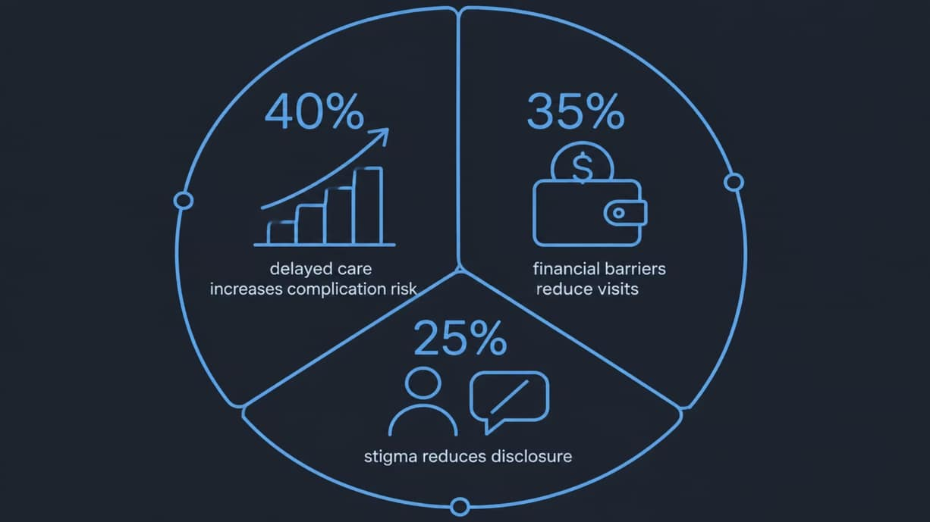
5 Reasons for delayed healthcare
Fear of diagnosis
Financial limitations
Lack of awareness
People delay care due to anxiety and fear — early signs are missed.
Cost uncertainty prevents timely visits
and tests.
Symptoms are misinterpreted or minimized.
Social stigma
Healthcare anxiety
Community perceptions block open health-seeking behavior.
System complexity and mistrust create additional inertia.
VITamin MOM targets these interlinked barriers by combining clinical triage with emotional and financial support.

Slide 3

Why Current Solutions Fail?
Traditional Solutions
VITamin MOM
Generic symptom checkers with rule-based questions
AI-driven conversational triage that adapts to user emotions
No emotional or behavioral detection
Built-in emotional barrier detection to surface fears and stigma
Limited to clinical guidance — reactive care
Proactive, mother-like guidance encouraging early intervention
No financial navigation or affordability recommendations
Integrated financial support suggestions (subsidies, low-cost clinics)
The gap is not clinical knowledge — it’s human-centered delivery. VITamin MOM closes that gap.

Slide 4

How It Works — User Flow
Submit Symptoms
VITamin MOM AI
Symptom Triage
Barrier Detection
Guidance & Resources
From first symptom to actionable next steps — conversational AI identifies medical risk and the human barriers preventing care, then routes users to appropriate resources.

Slide 5
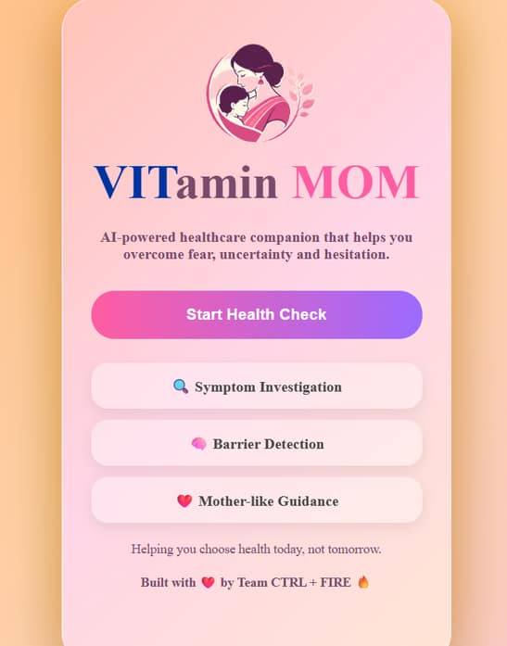
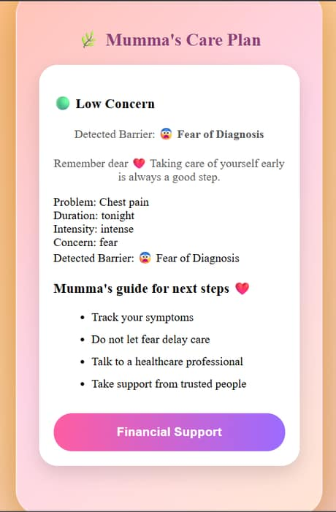


OUR WEBSITE
Disclaimer : this is a prototype based on out planning and knowledge. Actual website may vary in designs and functionality.
💻 Scan for GitHub Repository
🌐 Scan for Live Website
Homepage Interface
Personalized Action Plan
Github Repository : https://github.com/ps0303115-cell/VITamin-MOM.git
Live Demo : https://ps0303115-cell.github.io/VITamin-MOM/
Built using HTML • CSS • JavaScript • GitHub Pages • Figma

Slide 6


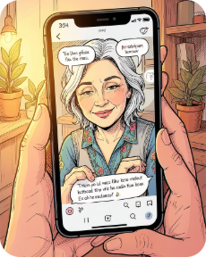
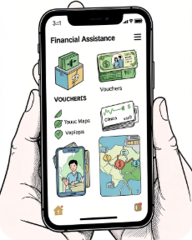
Core Features
Symptom Investigation
Barrier Detection
Mother-like Guidance
Financial Support
AI-guided, evidence-backed evaluation with adaptive questioning and risk stratification.
Identifies fear, stigma, and financial constraints using conversation signals and prompts supportive interventions.
Empathetic nudges, plain-language explanations, and culturally sensitive encouragement to seek care.
Personalized recommendations for low-cost clinics, subsidies, and step-by-step payment plans.

Slide 7
Business Model
Free Version
Premium Version
AI Symptom Investigation
Barrier Detection & basic guidance
Self-help resources and clinic locators
Smart Band integration & continuous monitoring
Advanced predictive insights and personalized reports
Priority support, emergency alerts, and clinician connections
Low-friction entry to build engagement and trust at scale.
SaaS + device kit revenue, recurring subscription, B2B partnerships with clinics and NGOs.
Pricing Cards
Go-to-Market
Free • Premium • Enterprise (health systems)
Community health workers, NGO pilots, employer wellness programs, and telehealth partnerships.

Slide 8

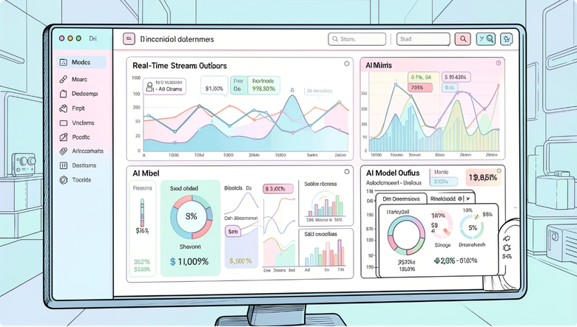
Technical Architecture
Wearable Band
Secure Data Ingest
Real-Time Collection
AI Processing
Key capabilities
Edge preprocessing on-band for privacy-preserving signals
Cloud ML for continuous model updates and personalization
Secure APIs for clinic referrals and subsidies lookup
Human-in-the-loop escalation for complex cases

Slide 9
Future Roadmap
2026
1
Launch VITamin MOM Platform — conversational AI & pilot studies
2
2027
Wearable integration and expanded monitoring features
2028
3
Hospital & clinic partnerships — referral and clinician integrations
4
2029
AI predictive healthcare deployments for population health
2030
5
Nationwide healthcare ecosystem — insurer and public health integrations

Slide 10


THANK YOU
"Be the reason someone chooses their health today, not tomorrow."
Made with 💖 by Team: CTRL + FIRE
1.Tanishq Srivastava - Research & Content
2.Parth Singh - Development & Deployment
3.Arima Srivastava - Design & Documentation
CTRL+FIRE

